Slide 1
JS day 3
functional programming
objects in javaScript

Slide 2
DOM
Når browseren loader websiden, skaber den sidens 'DOM’,
der står for
Document
Object Model.
DOM er en struktureret model af websiden,
en træ-struktur opsætning, som du kender fra f.eks. Windows stifinder.

Slide 3
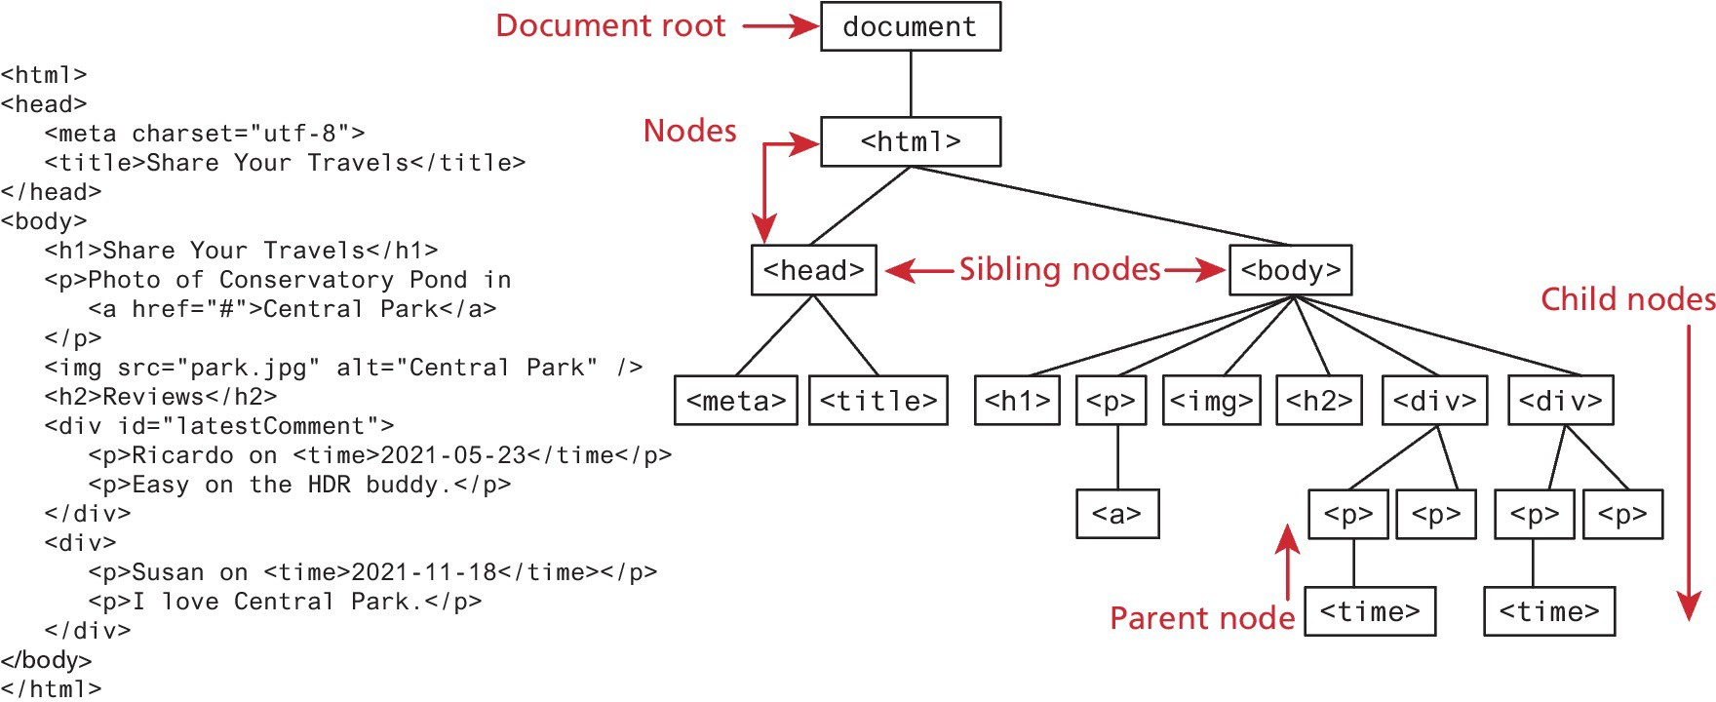
The Document Object Model (DOM)

Slide 4
Document Object
The DOM document object is the root JavaScript object representing the entire HTML document. It is globally accessible via the document object reference.
The properties of a document cover information about the page. Some are read-only, but others are modifiable. Like any JavaScript object, you can access its properties using either dot notation or square bracket notation
// retrieve the URL of the current page
let a = document.URL;
// retrieve the page encoding, for example ISO-8859-1 let b = document["inputEncoding"];

Slide 5
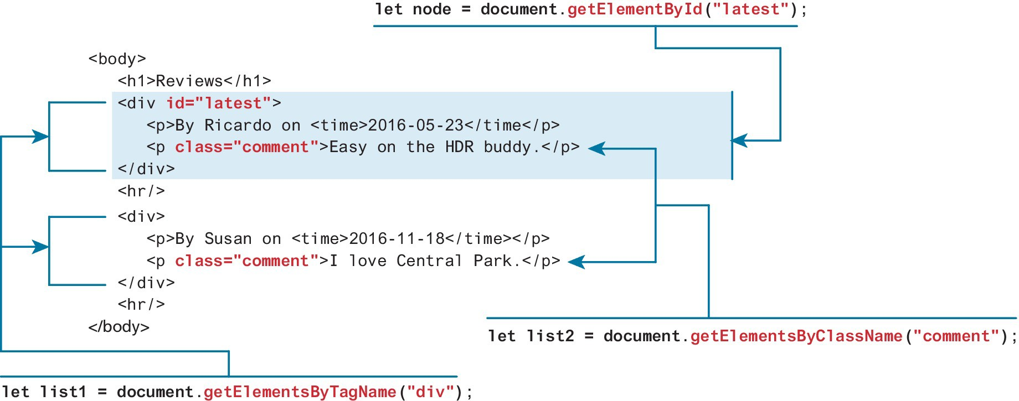
Selection Methods
The most important DOM methods
They allow you to select one or more document elements. The oldest 3 are: getElementById("id"), getElementsByClassName("name") and getElementsByTagName("name")

Slide 6
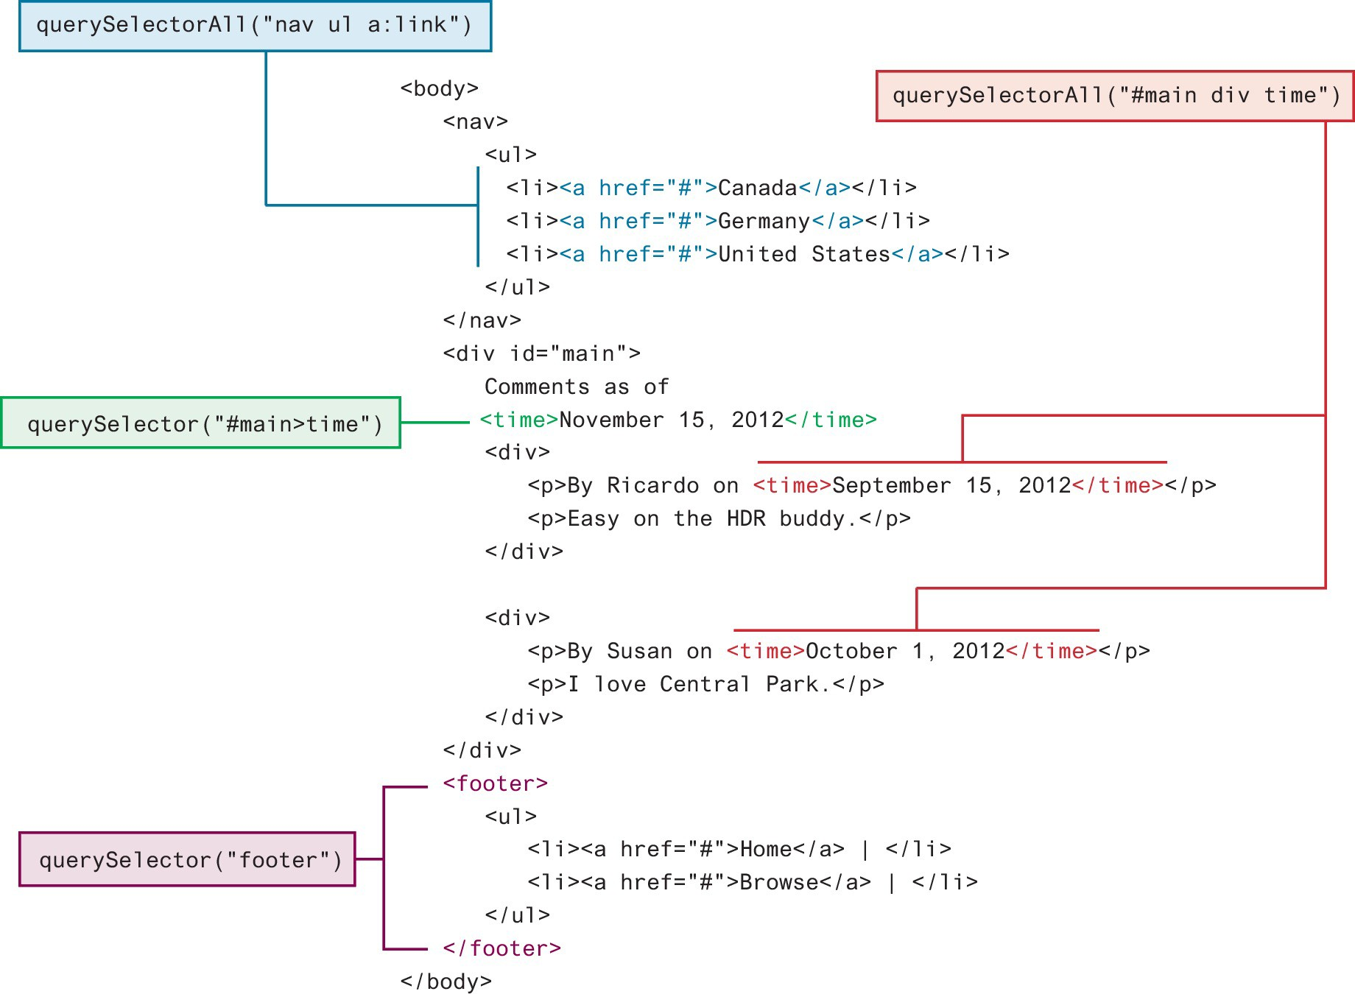
Query Selection Methods(recommend)
The newer querySelector() and querySelectorAll() methods allow you to query for DOM elements much the same way you specify CSS styles

Slide 7
Some Essential Element Node Properties
classList A read-only list of CSS classes assigned to this element. This list has a variety of helper methods for manipulating this list.
className The current value for the class attribute of this HTML element.
id The current value for the id of this element.
innerHTML Represents all the content (text and tags) of the element.
style The style attribute of an element. This returns a CSSStyleDeclaration object that contains sub-properties that correspond to the various CSS properties.
tagName The tag name for the element.

Slide 8
Changing an Element’s CSS Style
To programmatically modify the styles associated with a particular element one must change the properties of the style property for that element
For instance, to change an element’s style, we could use the following code:
https://www.w3schools.com/js/tryit.asp?filename=tryjs_change_style

Slide 9
DOM Manipulation-HTML
For instance, you could change the content of the <div> in using the following:
const div = document.querySelector("#main"); div.innerHTML = '<a href="#"><img src="ab.gif"></a>’;
This replaces the existing content with the new content.

Slide 10
DOM Manipulation Methods
appendChild Adds a new child node to the end of the current node.
createAttribute Creates a new attribute node.
createElement Creates an HTML element node.
createTextNode Creates a text node.
insertAdjacentElement Inserts a new child node at one of four positions relative to the current node.
insertAdjacentText Inserts a new text node at one of four positions relative to the current node.
insertBefore Inserts a new child node before a reference node in the current node.
removeChild Removes a child from the current node.
replaceChild Replaces a child node with a different child.

Slide 11

DOM Event

Slide 12
DOM loading
Before finishing this section on using the DOM, it should be emphasized that the timing of any DOM code is very important.
You cannot access or modify the DOM until it has been loaded.
To wait until we know for sure that the DOM has been loaded requires knowledge from our next section on event handling.

Slide 13
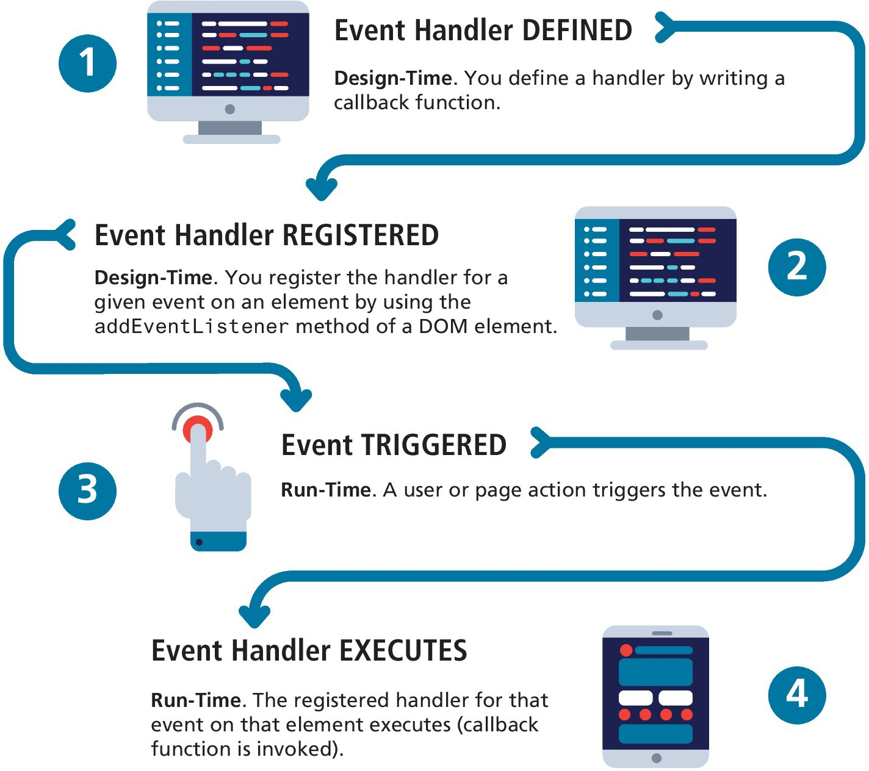
JavaScript Event Handling

Slide 14
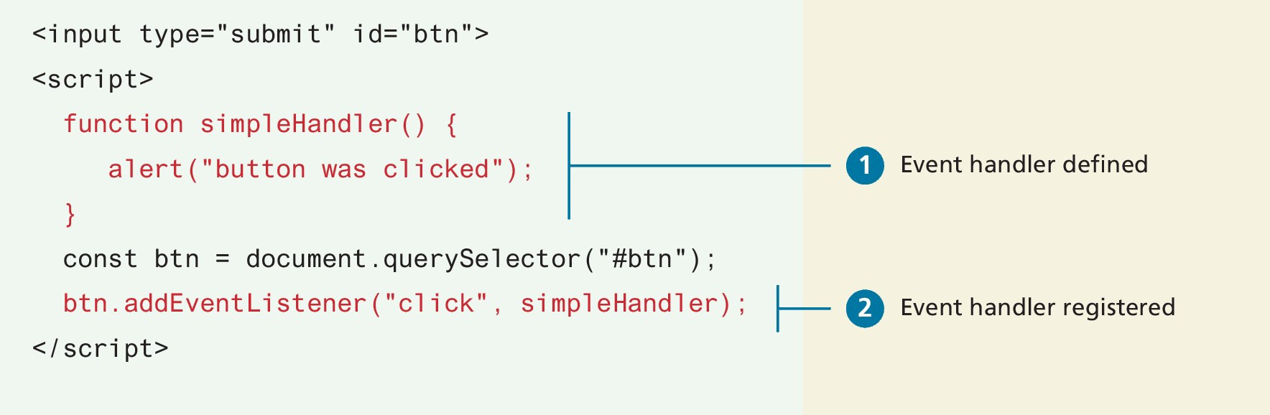
Implementing an Event Handler
An event handler is first defined, then registered to an element node object.
Registering an event handler requires passing a callback function to the addEventListener()

Slide 15
Event Types
There are many different types of events that can be triggered in the browser.
Perhaps the most obvious event is the click event, but JavaScript and the DOM support several others.
In actuality, there are several classes of event, with several types of events within each class specified by the W3C. Some of the most commonly used event types are:
mouse events,
keyboard events,
touch events,
form events, and
frame events.

Slide 16
Mouse Events
click The mouse was clicked on an element.
dblclick The mouse was double clicked on an element.
mousedown The mouse was pressed down over an element.
mouseup The mouse was released over an element.
mouseover The mouse was moved (not clicked) over an element.
mouseout The mouse was moved off of an element.
mousemove The mouse was moved while over an element.

Slide 17
Try yourself
https://www.w3schools.com/jsref/tryit.asp?filename=tryjsref_onclick_addeventlistener

Slide 18
Form Events
blur Triggered when a form element has lost focus (i.e., control has moved to a different element), perhaps due to a click or Tab key press.
change Some <input>, <textarea>, or <select> field had their value change. This could mean the user typed something, or selected a new choice.
focus Complementing the blur event, this is triggered when an element gets focus (the user clicks in the field or tabs to it).
reset HTML forms have the ability to be reset. This event is triggered when that happens.
select When the users selects some text. This is often used to try and prevent copy/paste.
submit When the form is submitted this event is triggered. We can do some prevalidation of the form in JavaScript before sending the data on to the server.

Slide 19
demo
Autocomplete form
https://www.w3schools.com/howto/tryit.asp?filename=tryhow_js_autocomplete

Slide 20
Case opgave

